Slide 1
Predictive Modeling of Public Procurement Contract Values in Uganda
By :Amal Abdirahman Mohamed
30.April.2026

Slide 2
Problem Statement
The Issue: Public procurement in Uganda often lacks automated financial oversight, making it difficult to detect when a government tender is overpriced or fraudulent.
Manual Limitations: Auditing thousands of records from different government bodies is slow and prone to human error.
Financial Risk: Without a data-driven benchmark, public funds can be lost through over-spending on "Works" or "Supplies" contracts.

Slide 3
: Project Goals & Solution
The Primary Goal: To develop a machine learning tool that performs Regression Analysis to predict the fair market value of procurement contracts in UGX.
Objective: To create a "Fair Market Price" estimator that serves as a baseline for government auditors.
The Solution: An automated "Red Flag" system where any bid significantly higher than the model’s prediction is marked for immediate investigation, enhancing financial transparency.

Slide 4
Data Definition
Dataset Identity: The project uses localized financial data from the Uganda Public Procurement and Disposal of Public Assets (PPDA).
Volume: It contains 1,100 unique samples, meeting the university requirement of $\ge1000$ rows
Data Characteristics:
Target Variable (Label): Contract Value (UGX)—the continuous numerical amount we want to predict.
Features (Predictors): Entity (Government body), Category (Works vs. Supplies), Region (Location), and Bids (Number of applicants).
Uniqueness: This data features specific records from organizations like UNRA and the Ministry of Health, making it an original project that hasn't been used in standard online tutorials.

Slide 5
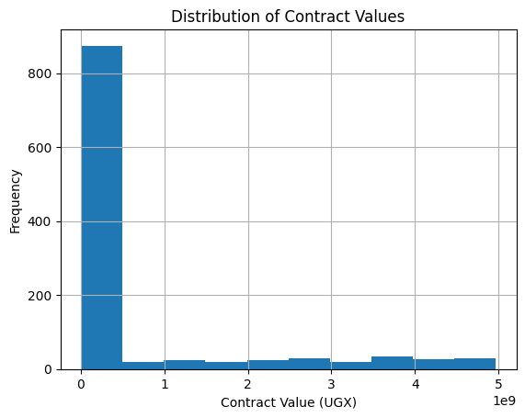
Data Exploration & Visualization
Univariate Visualization: analyze single variables, such as a histogram of "Contract Values," to understand the distribution and identify outliers.

Slide 6
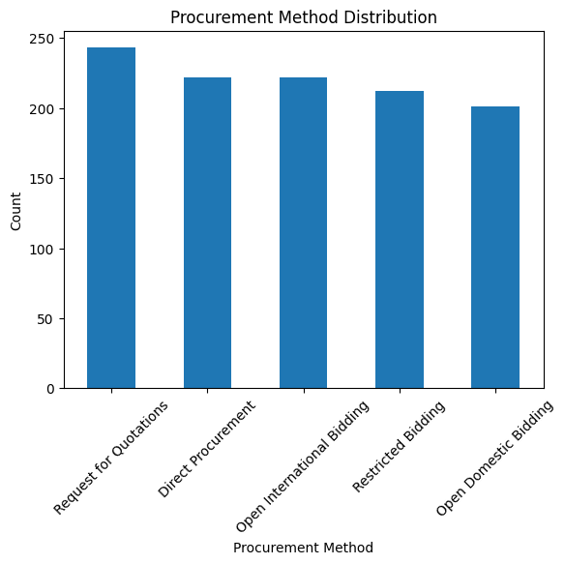
Univariate-Procurement Method

Slide 7
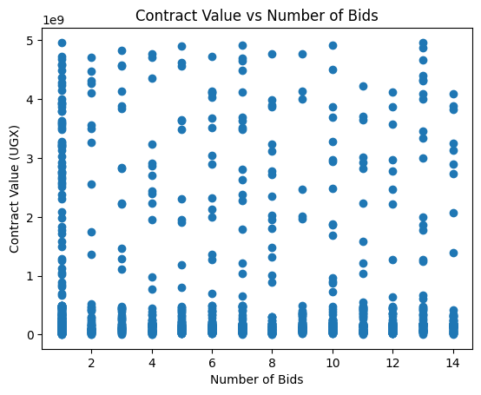
Multivariate Visualization:
You examine relationships, such as a boxplot comparing "Contract Value" against different "Regions" or "Categories"

Slide 8
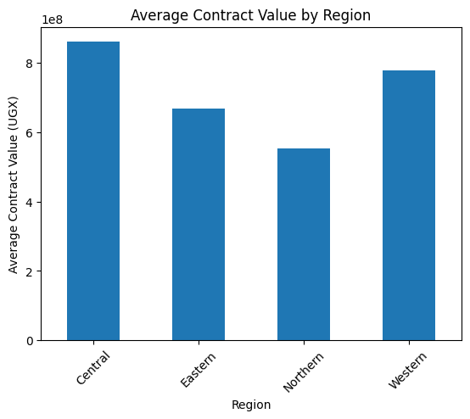
Multivariate-Region by value
Interpretation: These graphs demonstrate the data patterns, such as which regions consistently have the highest-valued projects, before the machine learning begins.

Slide 9

Methodology & Neural Network Logic
Model Comparison: Classical ML by Deep Learning
Random Forest Regressor (Classical ML): This model acts as an ensemble of many "Decision Trees." It is highly effective for structured data because it averages the results of multiple trees to provide a stable baseline prediction for contract values.
Artificial Neural Network (ANN): This is a deep learning model inspired by the human brain. It uses layers of interconnected "neurons" to find complex, non-linear patterns in the procurement data that a standard model might miss.

Slide 10
Cont…
Deep Dive: The Cost Function (The "U-Shaped Bowl")The Cost Function is the mathematical tool used to measure how "wrong" the model's predictions are compared to the actual historical contract values.
Visualizing the Error: In your slides, this is represented as a convex, U-shaped curve. The vertical axis (height) represents the total error (Loss), and the horizontal axis represents the model's internal weights.
The Starting Point: When training begins, the model’s weights are random, meaning the error is high. This is like placing a ball at the very top rim of the bowl.

Slide 11
cont….
The Global Minimum: The "bottom" of the bowl represents the Global Minimum. This is the exact point where the difference between the predicted price and the actual price is at its absolute lowest.
The Goal of Training: The entire purpose of the "Forward and Backward" pass is to move the model from the high-error rim down to the bottom of the bowl. Once the model reaches this point, it is considered "optimized" and ready to predict fair market prices accurately.

Slide 12
Evaluation & Optimization
Definition:
MAE calculates the average difference between the model's predicted price and the actual historical price recorded in the PPDA dataset.
Localized Context: Because the target variable is measured in Ugandan Shillings (UGX), the MAE provides a specific "error margin" in the same currency.
Operational Goal: This metric is vital for financial oversight. For instance, if your model has an MAE of 1,000,000 UGX, an auditor knows that a bid exceeding the prediction by 50,000,000 UGX is a statistical "Red Flag" that requires investigation for potential over-spending.

Slide 13
Cont…
2. Avoiding Overfitting: Training and Validation Loss
A major challenge when working with a localized dataset of 1,100 rows is ensuring the model doesn't just "memorize" specific examples, a problem known as Overfitting.
The Loss Graph: You monitor a visualization with two lines: Training Loss (error on data the model is learning from) and Validation Loss (error on "new" data the model hasn't seen).
Detecting Memorization: If the Training Loss continues to drop while the Validation Loss starts to rise, it proves the model is losing its ability to generalize.
Model Health: By keeping these two lines close together, you prove to the examiners that your model can accurately predict contract values for government entities it wasn't specifically trained on.

Slide 14
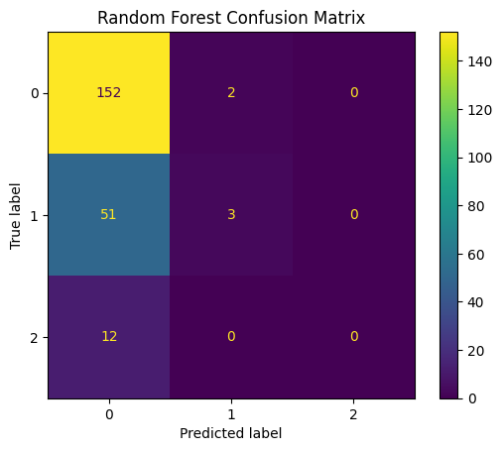
Model Evaluation(Confusion Matrix)

Slide 15

3. Optimization Technique:
Early Stopping acts as an automated "quality control" mechanism during the training of your Artificial Neural Network (ANN).
How it Works: As the model trains over several cycles (epochs), the system constantly checks the performance on the validation set.
The Logic: If the validation error stops improving for a set number of rounds, the algorithm assumes the model has reached its peak learning capacity.
The Outcome: The training is automatically terminated, and the system "rolls back" to save the version of the model with the lowest possible validation error.
The Benefit: This ensures your final project demo uses the most optimized version of the model—one that is both highly accurate and robust enough to handle new procurement tenders in Uganda.

Slide 16
Conclusion: Transforming Oversight with Al
Real-World Impact: This project demonstrates that machine learning can be a powerful ally for transparency in Uganda by providing an automated "Fair Market Price" benchmark for public spending.
Data-Driven Accountability: By training on 1,100 unique records from the PPDA, the model has moved beyond theoretical exercises to handle the actual complexities of the Ugandan economy, including regional price variations and diverse contract categories.
Efficiency in Auditing: The implementation of Regression Analysis allows auditors to shift from manual, time-consuming reviews to a "Red Flag" system where only suspicious, high-value bids are flagged for investigation.
Technical Success: Through rigorous optimization using Early Stopping and MAE, we have developed a model that doesn't just memorize data but understands the underlying patterns of procurement values.

